Slide 1


Software Quality Assurance
Software Testing
Presented by
Shumail Zehra

Slide 2
Welcome!!

Slide 3
Software Testing

Slide 4
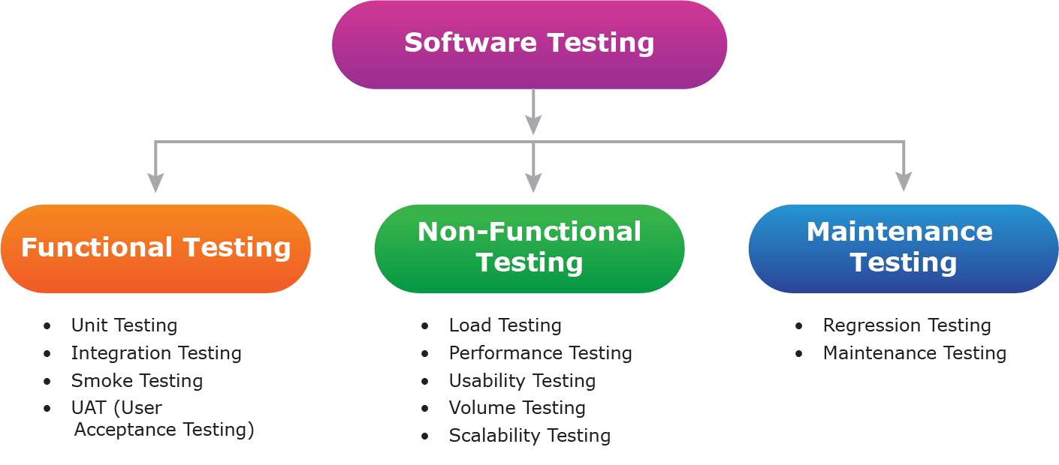

Slide 5
A strategy for software testing integrates the design of software test cases into a well-planned series of steps that result in successful development of the software
The strategy provides a road map that describes the steps to be taken, when, and how much effort, time, and resources will be required

Slide 6
Testing begins at the component level and work outward toward the integration of the entire computer-based system
Different testing techniques are appropriate at different points in time
Testing and debugging are different activities, but debugging must be accommodated in any testing strategy

Slide 7
Verification and Validation
Software testing is part of a broader group of activities called verification and validation that are involved in software quality assurance
Verification (Are the algorithms coded correctly?)
The set of activities that ensure that software correctly implements a specific function or algorithm

Slide 8
Validation (Does it meet user requirements?)
The set of activities that ensure that the software that has been built is traceable to customer requirements

Slide 9
Some Software testing types

Slide 10
Unit testing
Focuses testing on the function or software module
Concentrates on the internal processing logic and data structures
Is simplified when a module is designed with high cohesion
Reduces the number of test cases
Allows errors to be more easily predicted and uncovered
Concentrates on critical modules and those with high cyclomatic complexity when testing resources are limited

Slide 11
Validation testing
Provides final assurance that the software meets all functional, behavioral, and performance requirements
Integration testing
Focuses on inputs and outputs, and how well the components fit together and work together
Defined as a systematic technique for constructing the software architecture
At the same time integration is occurring, conduct tests to uncover errors associated with interfaces

Slide 12
Regression Testing
Each new addition or change to baselined software may cause problems with functions that previously worked flawlessly
Regression testing re-executes a small subset of tests that have already been conducted
Ensures that changes have not propagated unintended side effects
Helps to ensure that changes do not introduce unintended behavior or additional errors
May be done manually or through the use of automated capture/playback tools

Slide 13
Regression test suite contains three different classes of test cases
A representative sample of tests that will exercise all software functions
Additional tests that focus on software functions that are likely to be affected by the change
Tests that focus on the actual software components that have been changed

Slide 14
Smoke Testing
Taken from the world of hardware
Power is applied and a technician checks for sparks, smoke, or other dramatic signs of fundamental failure
Designed as a pacing mechanism for time-critical projects
Allows the software team to assess its project on a frequent basis
Includes the following activities
The software is compiled and linked into a build

Slide 15
A series of breadth tests is designed to expose errors that will keep the build from properly performing its function
The goal is to uncover “show stopper” errors that have the highest likelihood of throwing the software project behind schedule
The build is integrated with other builds and the entire product is smoke tested daily
Daily testing gives managers and practitioners a realistic assessment of the progress of the integration testing
After a smoke test is completed, detailed test scripts are executed

Slide 16
Recovery testing
Tests for recovery from system faults
Forces the software to fail in a variety of ways and verifies that recovery is properly performed
Tests reinitialization, checkpointing mechanisms, data recovery, and restart for correctness
Security testing
Verifies that protection mechanisms built into a system will, in fact, protect it from improper access

Slide 17
Stress testing
Executes a system in a manner that demands resources in abnormal quantity, frequency, or volume
Performance testing
Tests the run-time performance of software within the context of an integrated system
Often coupled with stress testing and usually requires both hardware and software instrumentation
Can uncover situations that lead to degradation and possible system failure

Slide 18
System testing
Verifies that all system elements (software, hardware, people, databases) mesh properly and that overall system function and performance is achieved

Slide 19
Review Questions
What is the difference between functional and non functional testing?
What is the difference between Stress and Performance Testing?
What does the term Regression explains?

Slide 20
Online Resources
https://www.youtube.com/watch?v=TDynSmrzpXw&list=PaLDC2A0C8D2EC934C7&index=2&t=0s
https://www.softwaretestinghelp.com/types-of-software-testing/

Slide 21
Thank you

